Slide 1
ANSI SQL
SQL Subqueries

Slide 2

Session Objectives
At the end of the session you will be able to
Define different SQL Functions
Define Sub-queries and its advantages.
Identify the rules of Sub-queries.
Describe how to use Sub-queries with the SELECT, INSERT, UPDATE and DELETE Statements.
Define the types of Sub-queries.
Define the use of IN, NOT IN, ALL, ANY, SOME, EXISTS, and NOT EXISTS.
Define the use of correlated Sub-queries.
Describe the use of difference between Correlated and non-correlated Sub-query.

Slide 3
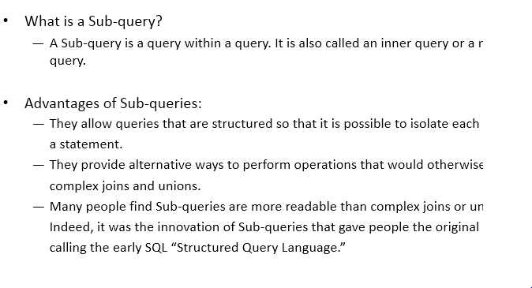
Sub-Query

Slide 4
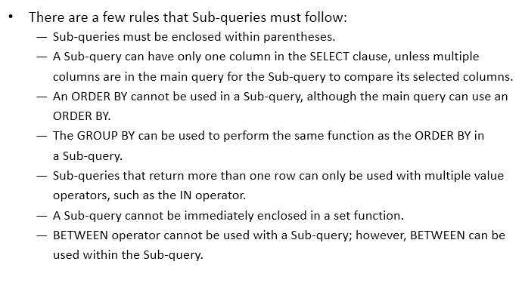
Sub-query Rules

Slide 5
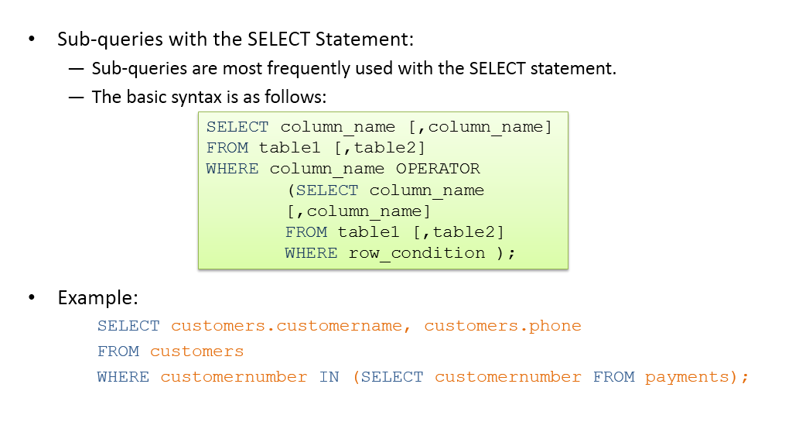
Sub-query :Select Statement

Slide 6
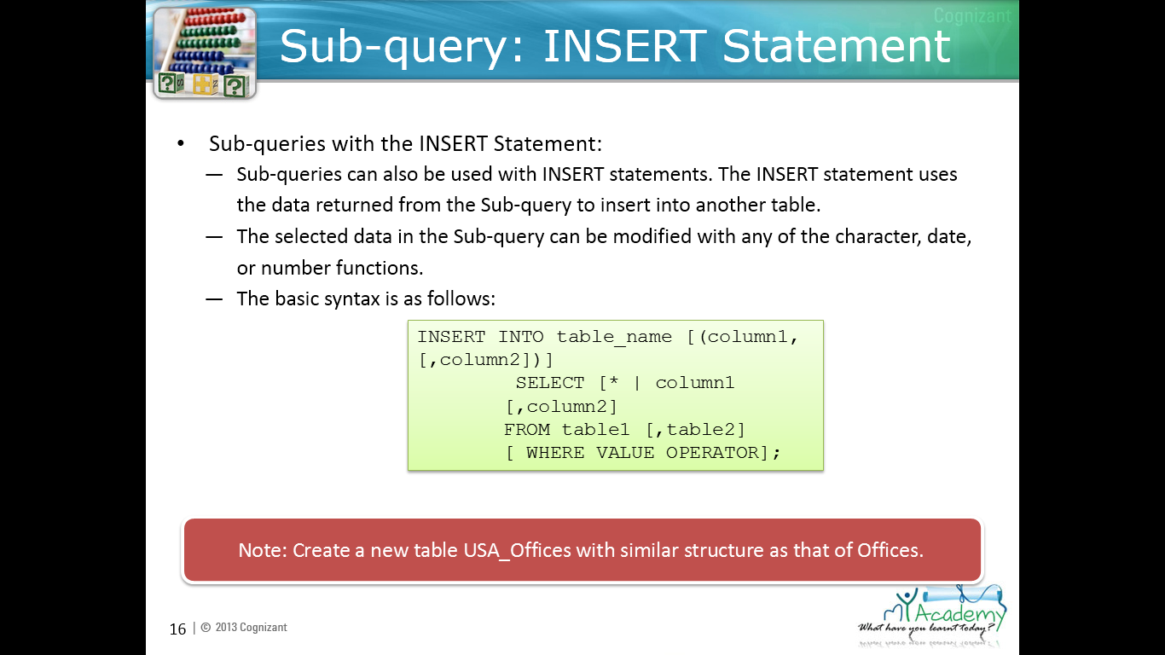
Sub-query: Insert statement

Slide 7
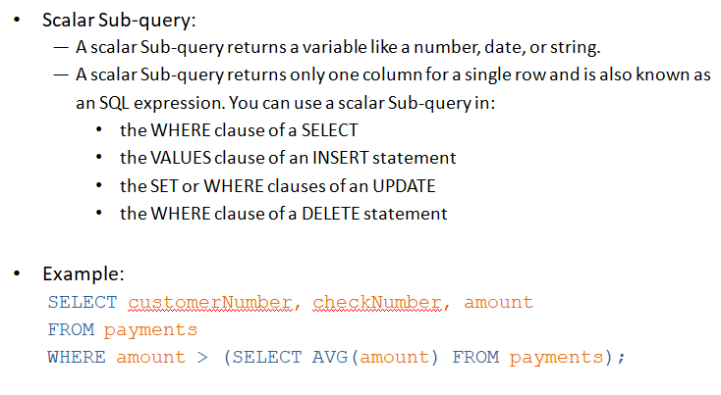

Slide 8
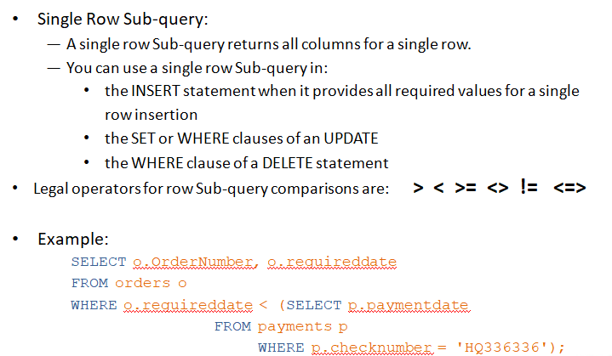

Slide 9

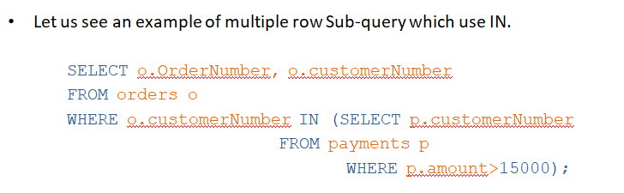

Slide 10
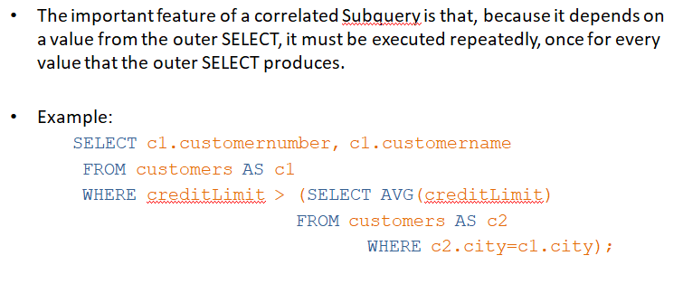

Slide 11
You have completed Functions & subqueries

